Slide 1
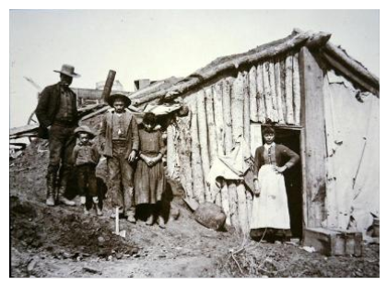
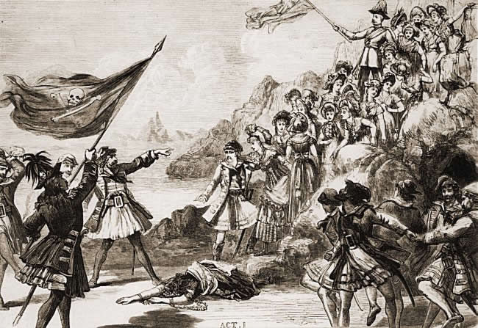
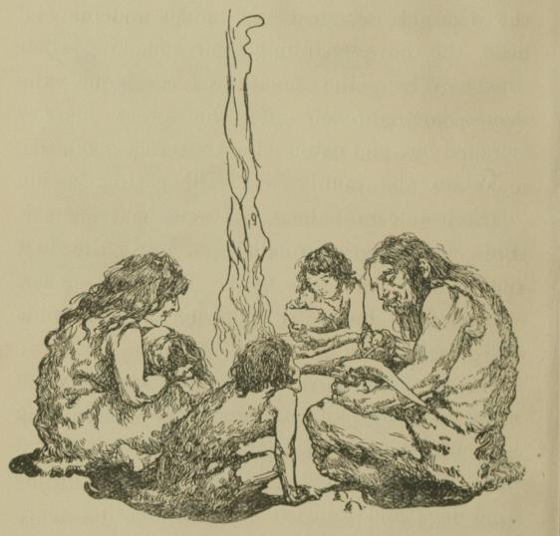
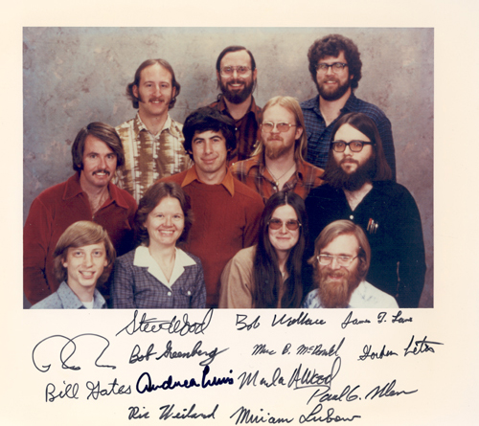
Ba 260: Intro to Entrepreneurship

Slide 2
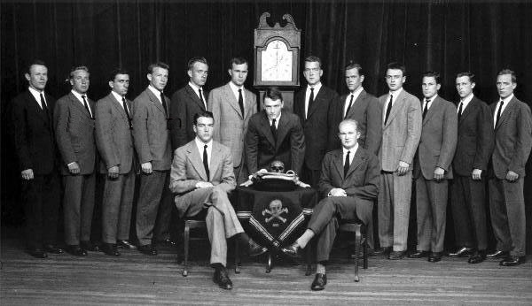
Course Overview
Skull and Bones a secret society that provides a type of identity to its members, can you spot George Bush?

Slide 3
Syllabus
Course Information:
Time: 2:00pm to 4:20pm
Location: Austin Hall 100
Instructor: David Vasquez
Email: david.vasquez@bus.oregonstate.edu
Dates: June 22, 2015 to July 17, 2015

Slide 4
Syllabus
Course Objectives:
Recognize what it takes to be a successful entrepreneur.
Analyze new business opportunities that exist in the marketplace.
Evaluate the feasibility of pursuing an opportunity that you’ve recognized.

Slide 5
Syllabus
Grading:

Slide 6
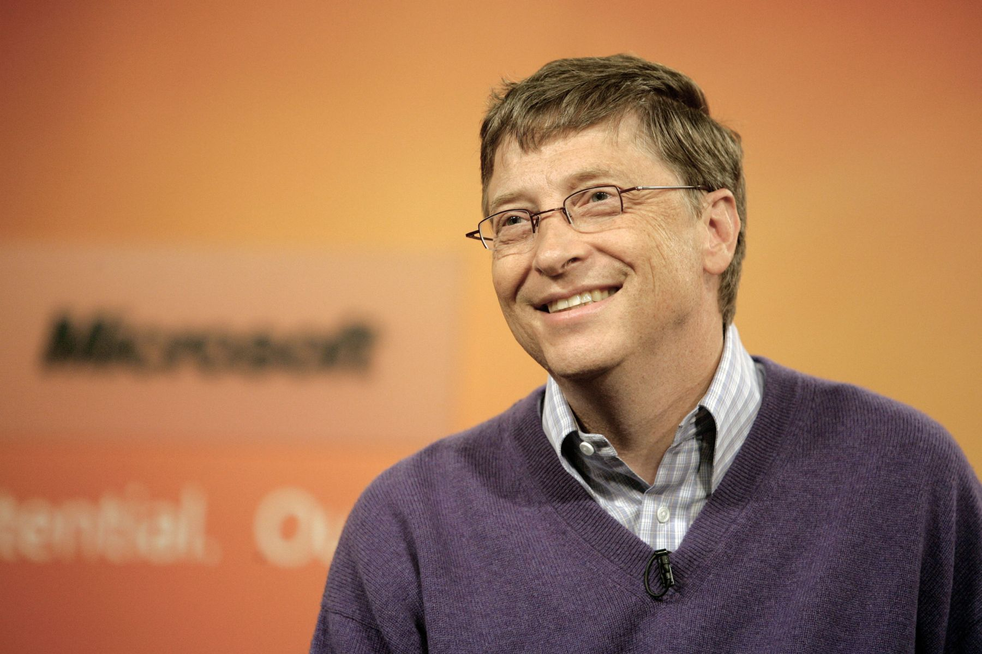
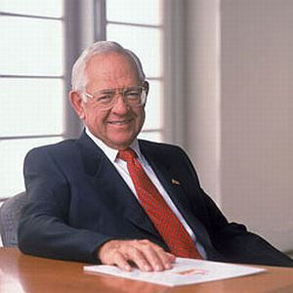
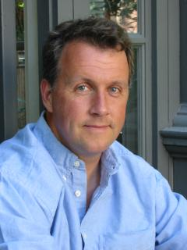
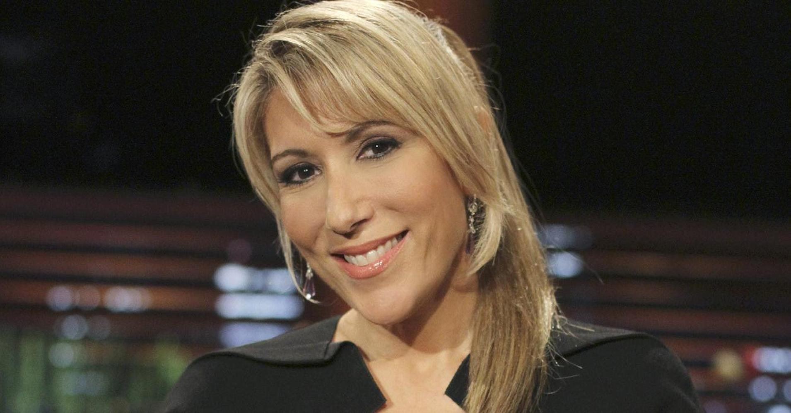
Individual entrepreneurs
Individual traits
Passion
Cognition
Entrepreneurs and teams
We will look at team motivation and identity
Notes:
Social environments are made up of communities, families, work teams, neighborhoods and other social groups that create a context for certain normative behaviors.

Slide 7
Individual entrepreneurs
Individual traits
Passion
Cognition
Entrepreneurs and teams
We will look at team motivation and identity
Notes:
Social environments are made up of communities, families, work teams, neighborhoods and other social groups that create a context for certain normative behaviors.

Slide 8
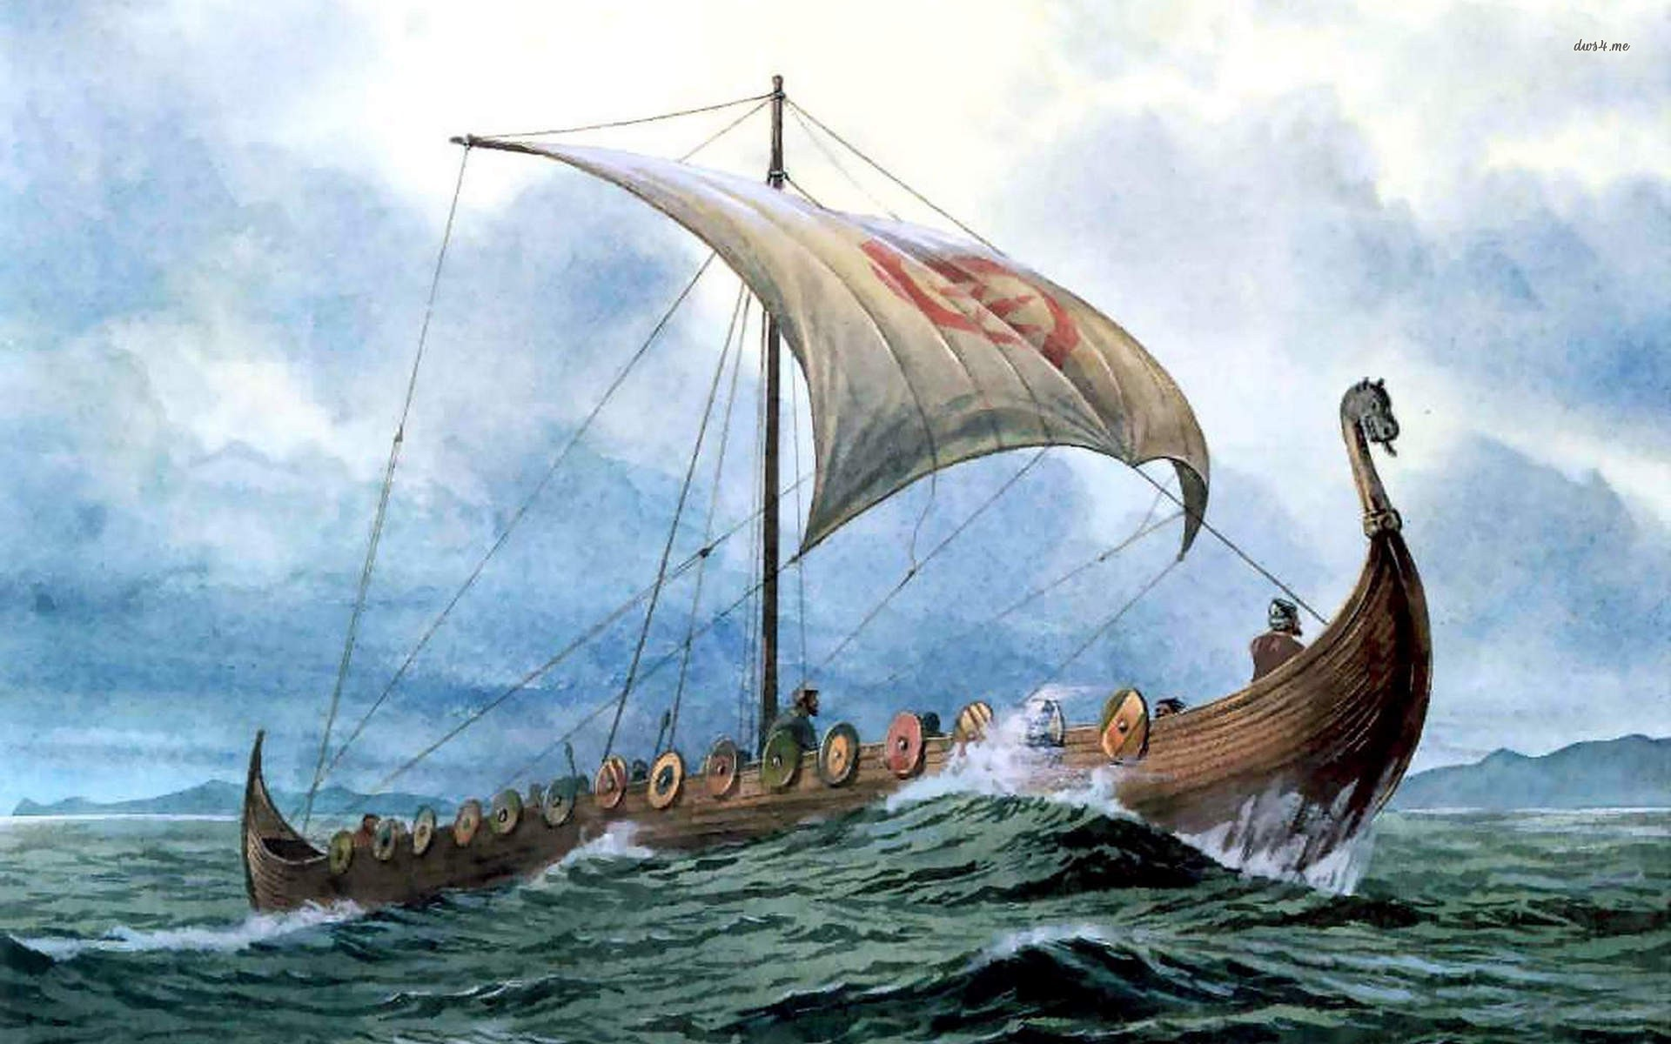
Literature Review and Previous Research
Social Identity Theory
Social environments (community, family, etc)
Cause Normative Behaviors
Self-Categorization- individual can categorize oneself as an object and be sort able into classifications
See groups as “us” and “them” often in psychology research see your group as superior
Viking raiders created a society where normative behavior felt raiding coastal settlements was a natural and “ok” function of society

Slide 9
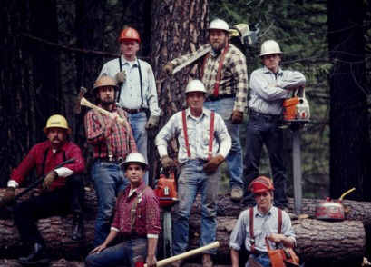
Theory Development

